Slide 1
Victor Silva
Infrastructure as Code on Azure
@vmsilvamolina

Slide 2
Infrastructure as Code

Slide 3
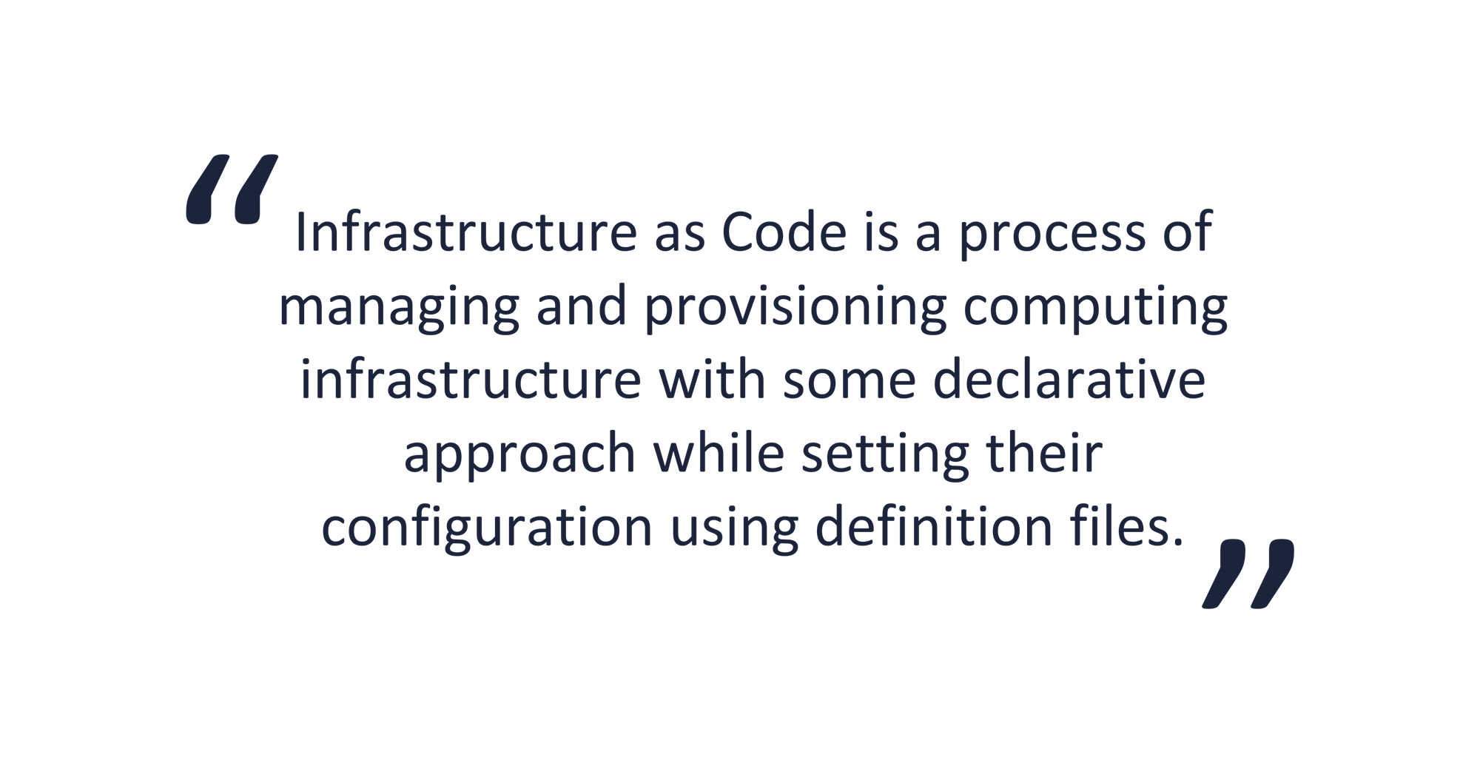

Slide 4
Consistency
Accelerating
Extensibility
Reusability

Slide 5
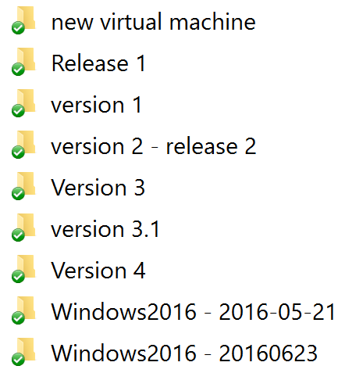

Slide 6


Slide 7
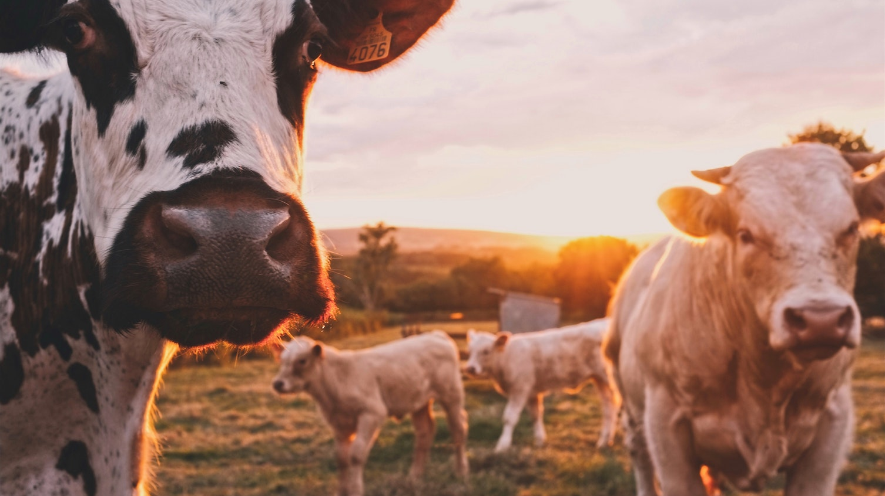
Treat your servers
like cattle,
not pets

Slide 8


Slide 9

https://thinkacloud.wordpress.com/2016/01/18/docker-for-the-enterprise-are-we-there-yet/

Slide 10






Slide 11
Ansible

Slide 12
> Agent-less communication.
> Easy learning curve.
> Playbook structure is simple and clearly structured.
> Procedural and Ordered.

Slide 13
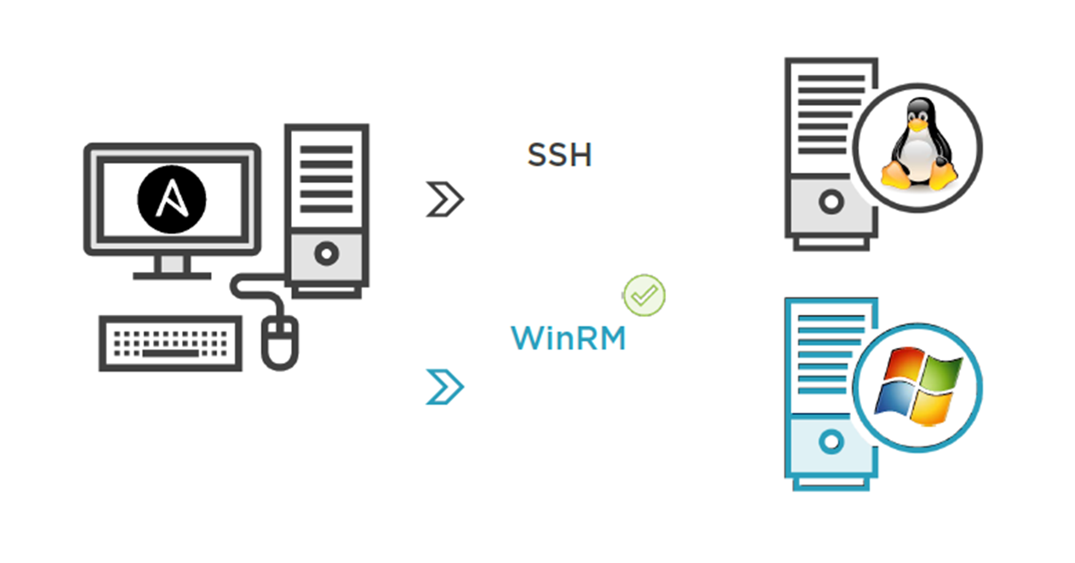


Slide 14
Runbook’s anatomy
---
- name: install apache
hosts: webservers
user: root
tasks:
name: install httpd
yum: name=httpd state=present
service: name=httpd state=running

Slide 15
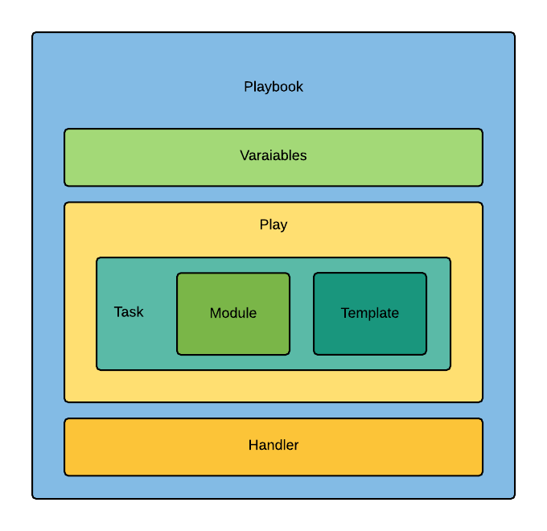

Slide 16

Azure Cloud Shell

Slide 17
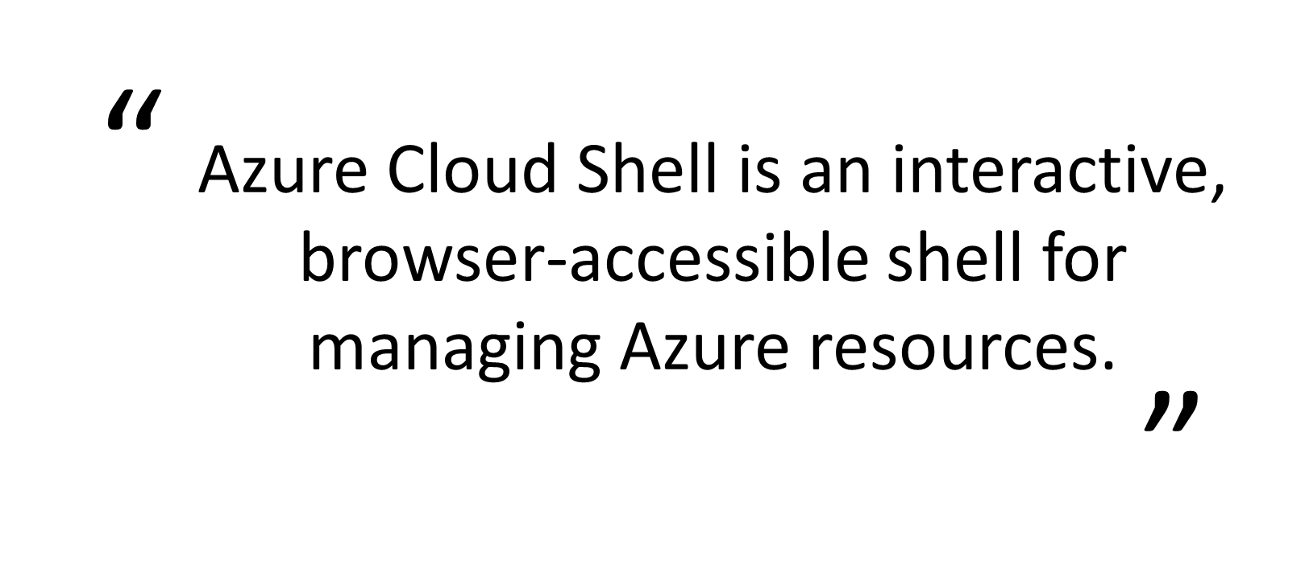

Slide 18
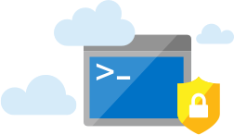
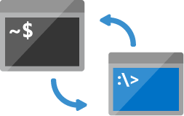

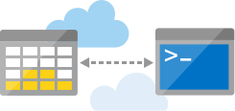
Shell access from virtually anywhere (https://shell.azure.com)
Choose your preferred shell experience (Bash and PowerShell)
Common tools and programming languages included
Persist your files in attached cloud storage

Slide 19
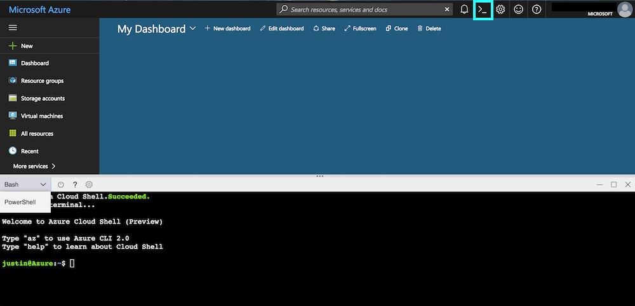

Slide 20


DEMO
> Create a Playbook.
> Manage Azure resources.
> Azure Cloud Shell tour.

Slide 21

If you think you will do a task twice – automate it!

Slide 22

ARM Templates

Slide 23
> ARM templates are a declarative way of describing your infrastructure.
> ARM templates are json files.
> Contain 4 sections: parameters, variables, resources and output

Slide 24
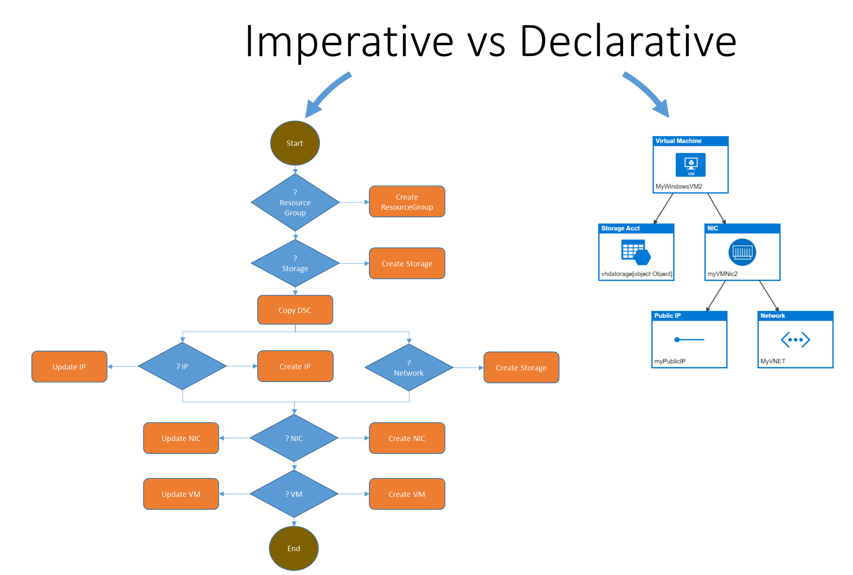

Slide 25
Azure Quickstart Templates:
https://azure.microsoft.com/en-us/resources/templates
Github repo:
https://github.com/Azure/azure-quickstart-templates

Slide 26
DEMO
> Generate a template.
> Deploy to Azure.

Slide 27

Azure Automation and PowerShell DSC

Slide 28
> A way to automate the manual, long running, frequently repeated tasks.
> Automatically performed at regular intervals.
> Runbooks + PowerShell DSC.

Slide 29
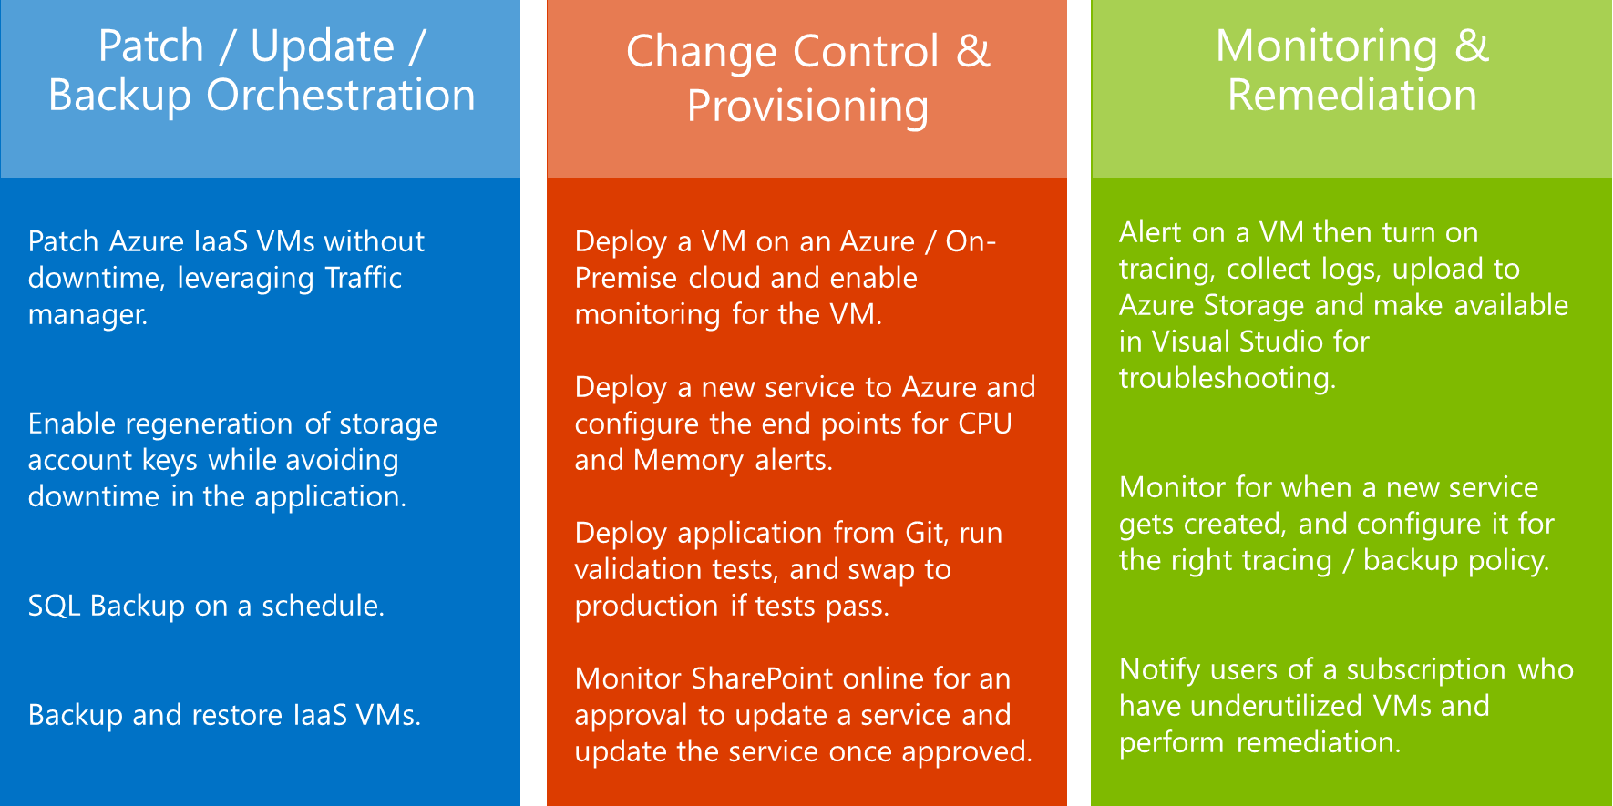

Slide 30
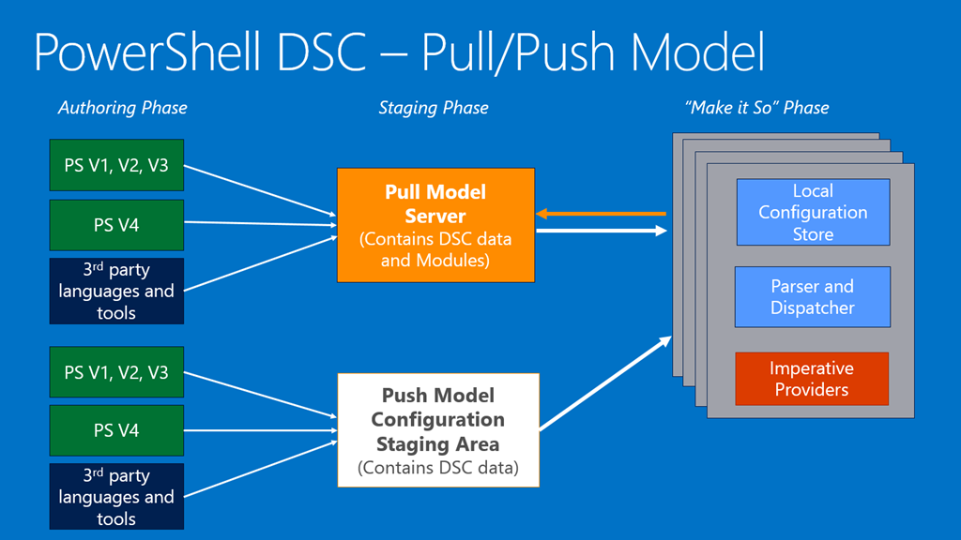

Slide 31
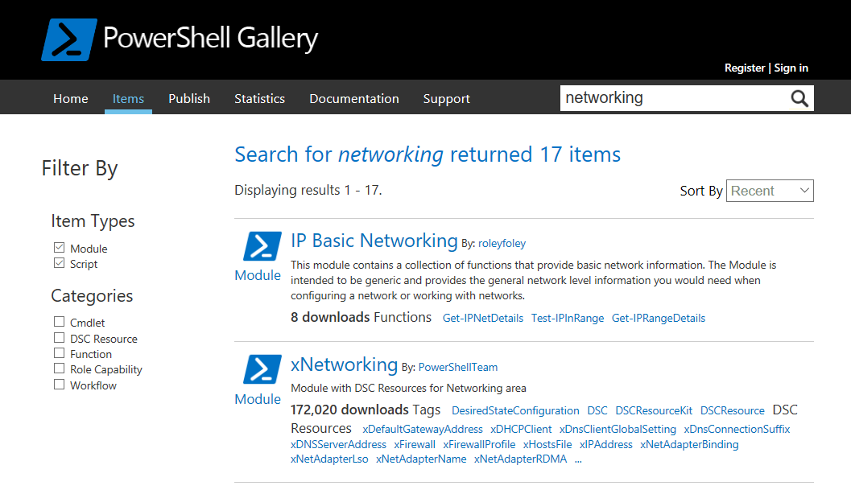

Slide 32
Next steps:
* Search
* Try
* Community

